Slide 1
Multi-Agent Chatbot
Generative
AI
Abhishek Sahoo, Ayush Chakraborty, Nishant Pandey, Vikram Pathak, Yash Joglekar

Slide 2
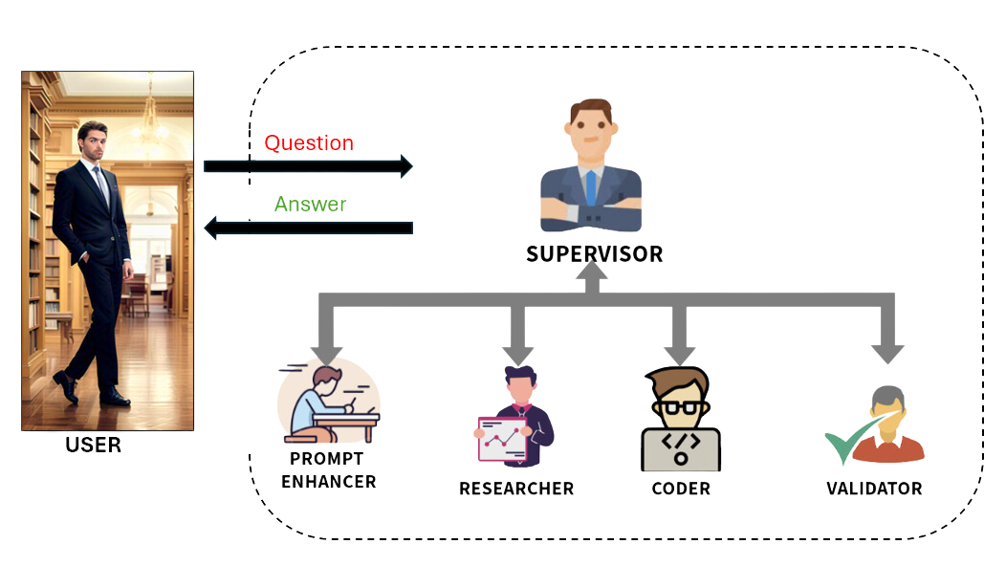
Introduction
The Multi-Agent Chatbot is an advanced conversational system designed to improve response accuracy and efficiency by utilizing multiple specialized agents.
A Supervisor Agent dynamically routes queries to the most suitable agent:
Enhancer for refining prompts
Researcher for fetching real-time information
Coder for executing technical tasks
Validator for ensuring answer correctness.

Slide 3
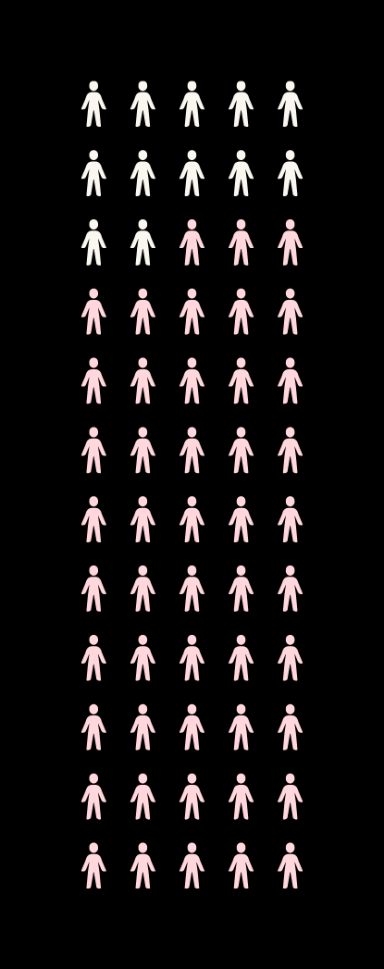
Why multiple agents?
Tasks are handled in a parallel and specialized manner.
Allows for scalability and modular design to improve chatbot efficiency.
Reduces reliance on a single model, improving accuracy and task handling.

Slide 4

Multi-Agent Design
Supervisor Agent: Routes tasks to the appropriate agent.
Enhancer Agent: Refines and clarifies vague user queries.
Researcher Agent: Fetches real-time information.
Coder Agent: Solves coding and analytical tasks.
Validator Agent: Ensures answer correctness and relevance.

Slide 5
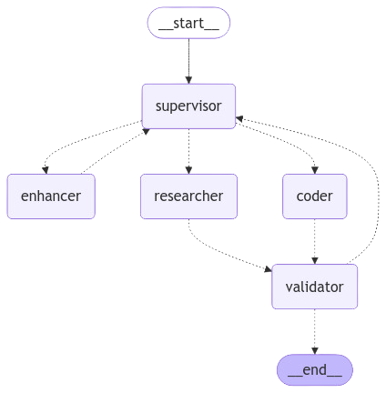
Work-Flow
User sends a query.
Supervisor Agent determines which agent should handle it.
Query is processed by Enhancer, Researcher, or Coder as needed.
Validator Agent reviews the output for correctness.
Final response is sent to the user.
Example Use Cases:
A user asks for the weather → Researcher Agent retrieves real-time data.
A user asks for Python code execution → Coder Agent processes and returns the output.

Slide 6

Key Challenges
Handling Conflicting Outputs:
When multiple agents generate responses, the system must resolve inconsistencies and merge insights coherently to provide a unified, accurate answer
Efficiency & Low Latency:
The chatbot must process queries quickly, optimize resource usage, and ensure that responses maintain high accuracy without unnecessary delays
Task Prioritization:
The Supervisor Agent must intelligently route tasks to the most suitable agent, avoiding redundant processing and ensuring optimal workflow execution

Slide 7
Conclusion
Key Takeaways:
Modular design improves chatbot intelligence and accuracy.
Specialized agents allow for better query handling.
Ensures correctness via validation mechanisms.
Future Scope:
Add more domain-specific agents (e.g., medical, legal, finance).
Improve NLP capabilities with better query understanding.
Optimize response speed using asynchronous processing.

Slide 8
THANK YOU

